Slide 1
KNN Classification
Noble Xavier

Slide 2
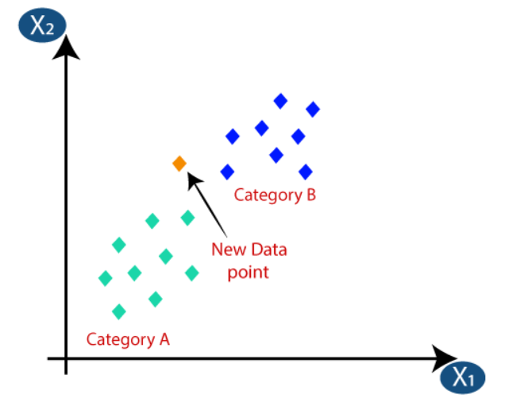
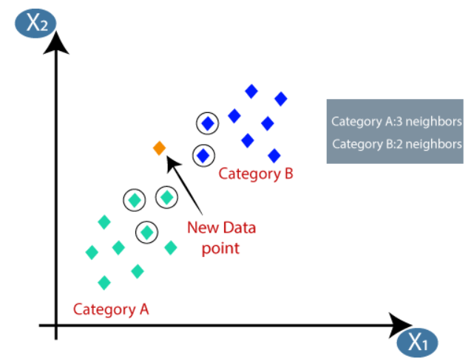
K-Nearest Neighbor(KNN)
K-Nearest Neighbours is one of the most basic yet essential classification algorithms in Machine Learning.
Suppose there are two categories, i.e., Category A and Category B, and we have a new data point x1, so this data point will lie in which of these categories. To solve this type of problem, we need a K-NN algorithm. With the help of K-NN, we can easily identify the category or class of a particular dataset
Consider K = 5, In this case, the 3 nearest neighbours are from category A, hence this new data point must belong to category A.
Suppose we have a new data point and we need to put it in the required category

Slide 3
K-Nearest Neighbor(KNN)
The steps for the KNN Algorithm in Machine Learning are as follows:
Step - 1: Select the number K of the neighbors
Step - 2: Calculate the Euclidean distance of each point from the target point.
Step - 3: Take the K nearest neighbors per the calculated Euclidean distance.
Step - 4: Among these k neighbors, count the number of the data points in each category.
Step - 5: Assign the new data points to that category for which the number of neighbors is maximum.

Slide 4
K-Nearest Neighbor(KNN)
Advantage
It is simple to implement.
It is robust to the noisy training data.
It can be more effective if the training data is large.
Disadvantage
Always needs to determine the value of K which may be complex sometimes.
The computation cost is high because of calculating the distance between the data points for all the training samples.

Slide 5
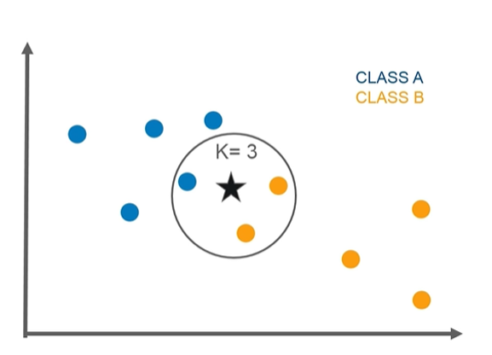
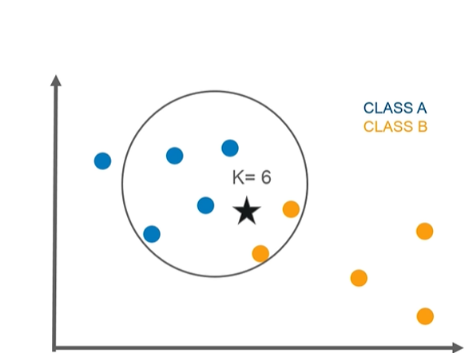
KNN Example
New Data Point is part of Class B
New Data Point is part of Class A

Slide 6
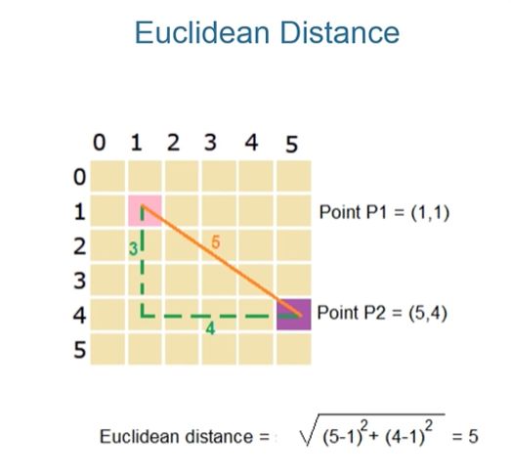
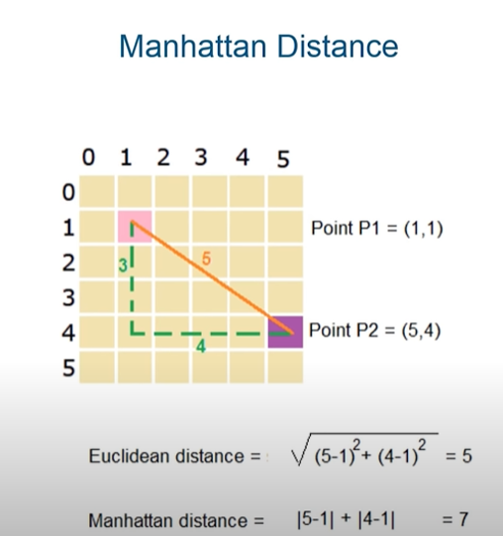
KNN- Distance

Slide 7
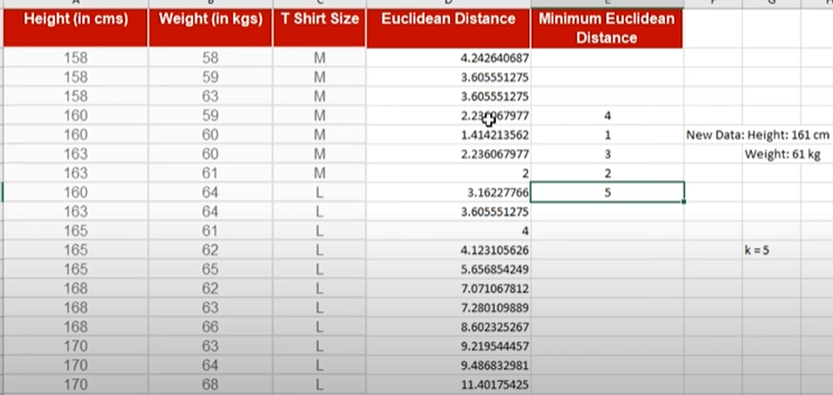
KNN- Example

Slide 8
ACCURACY

Slide 9
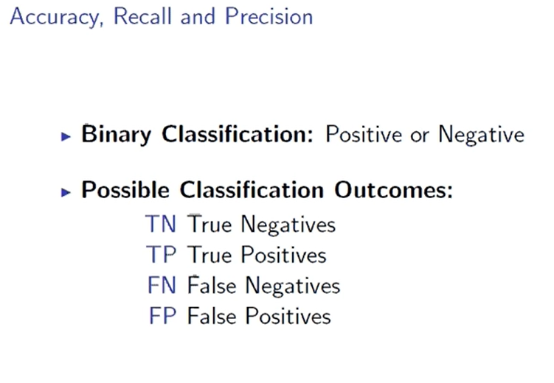

Slide 10
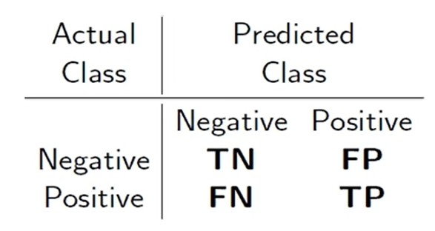
Confusion Matrix
True Positive(TP): Values that are actually positive and predicted positive.
False Positive(FP) (Type I Error): Values that are actually negative but predicted to be positive.
False Negative(FN) (Type II Error): Values that are actually positive but predicted to be negative.
True Negative (TN): Values that are actually negative and predicted to be negative.

Slide 11
Confusion Matrix
True Positive Rate(TPR): True Positive/positive
False Positive Rate(FPR): False Positive /Negative
False Negative Rate(FNR): False Negative/Positive
True Negative Rate(TNR): True Negative/Negative

Slide 12
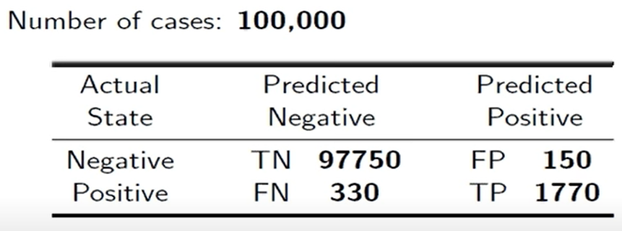
Confusion Matrix
TPR = TP/P = 1770/ (330+1770) = 1770/2100 = 84.28 %
TNR = TN/N = 97750/ (97750+150) = 97750/ 97900 = 99.84 %
FPR = FP/N =150/ (97750+150) = 150/ 97900 = 0.15 %
FNR = FN/P =330/ (330+1770) = 330/2100 = 15.71 %

Slide 13
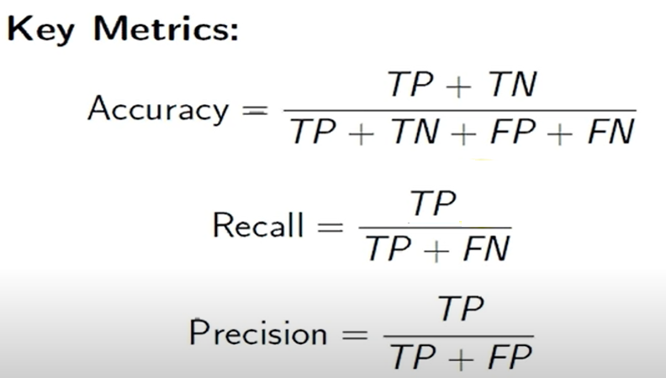
Precision and Recall
Precision = True Positive/Predicted Positive
Recall = True Positive/ Actual Positive

Slide 14
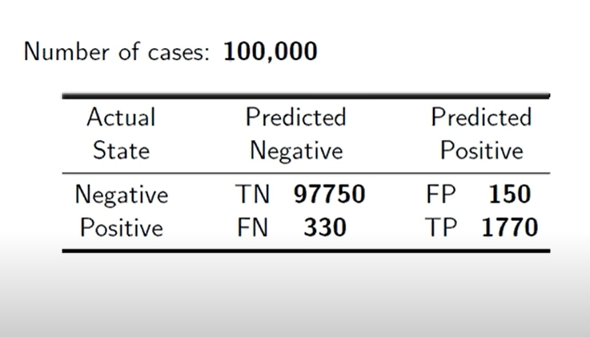

Slide 15
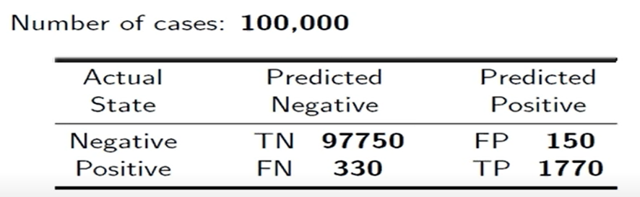
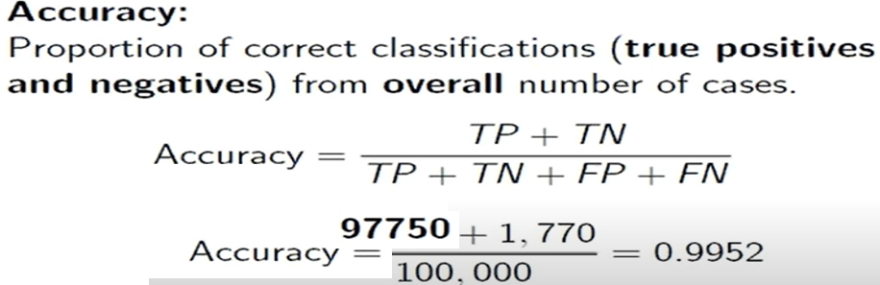

Slide 16
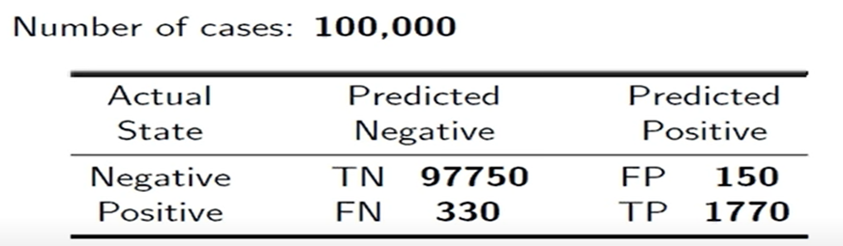
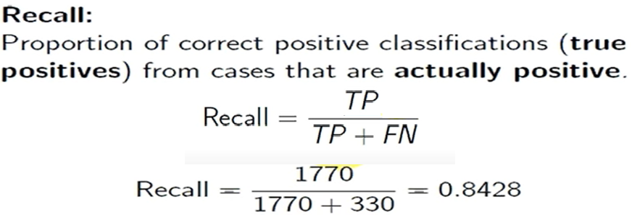
Recall

Slide 17
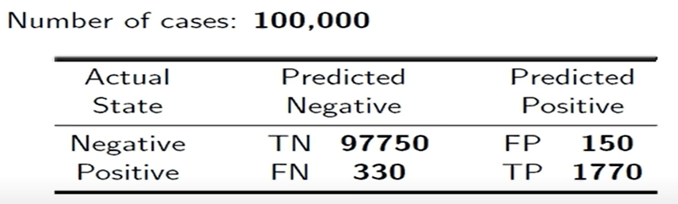
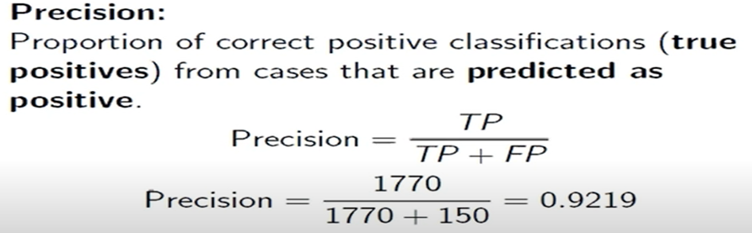
Precision

Slide 18
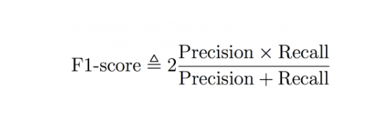

Slide 19
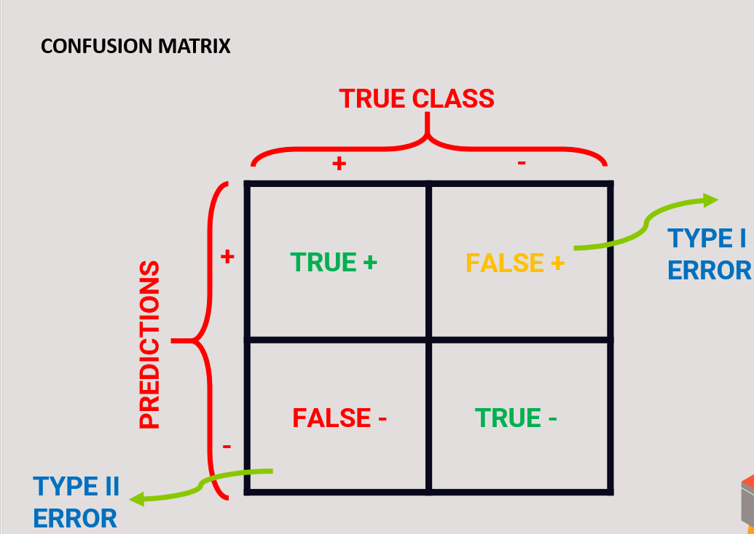

Slide 20
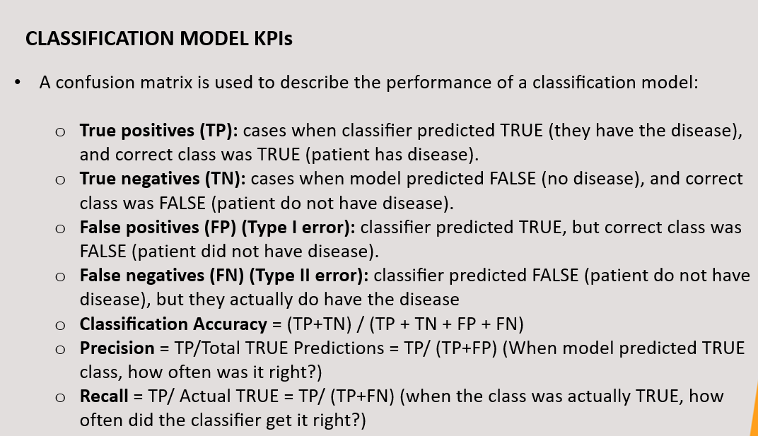

Slide 21
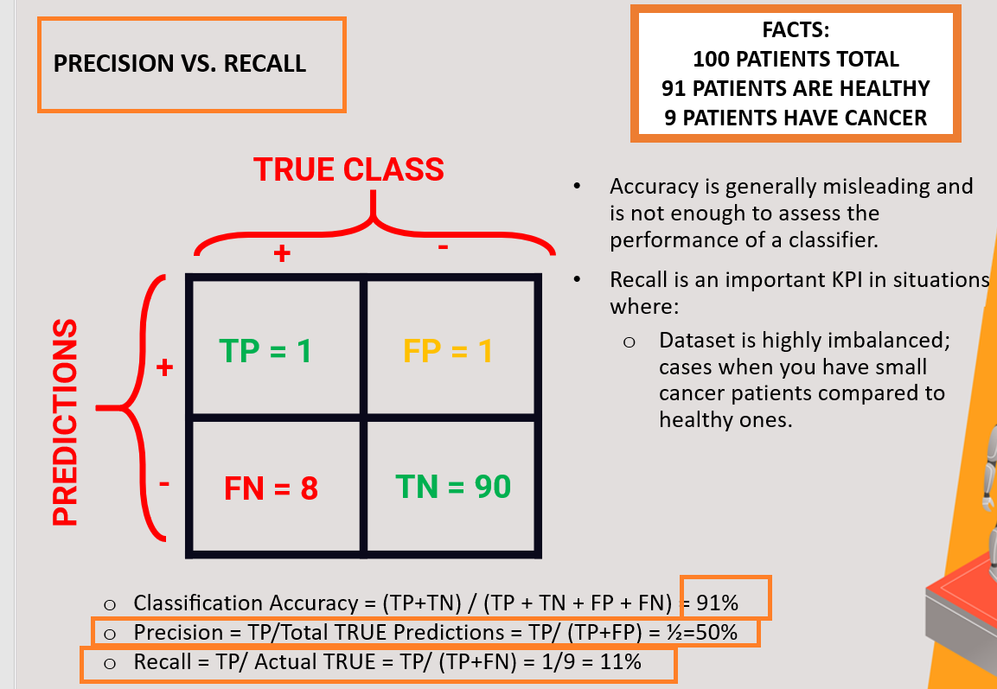

Slide 22
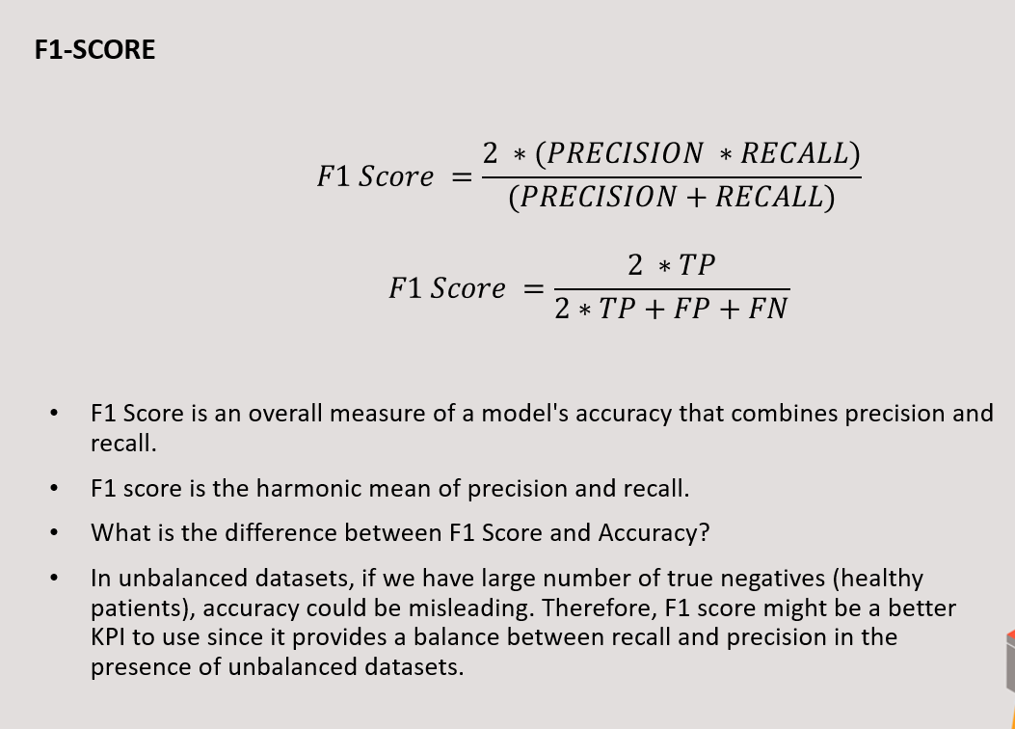

Slide 23
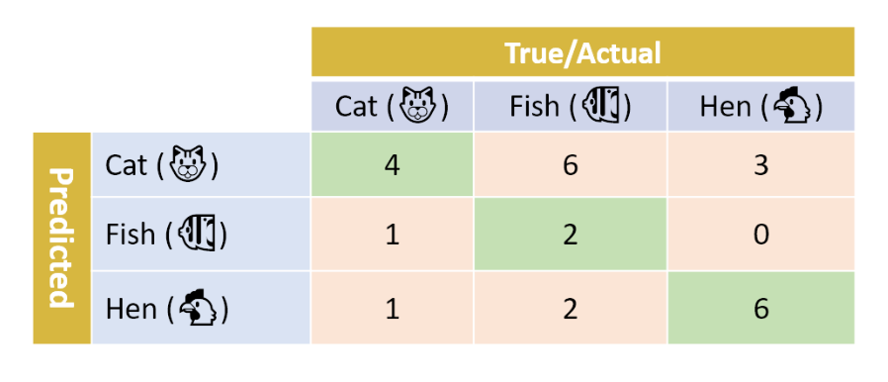
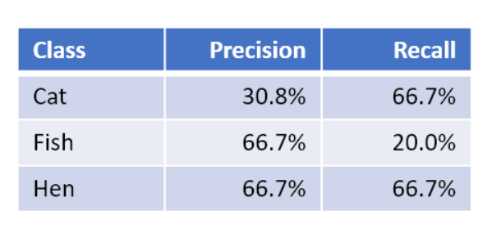

Slide 24

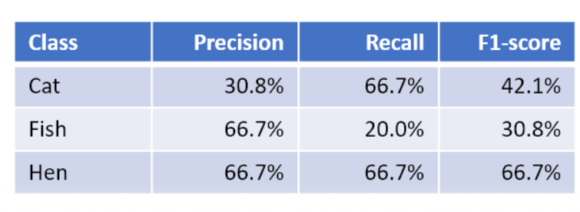

Slide 25

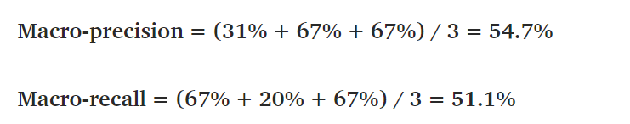
Macro-F1: Mean of our per-class F1-scores

Slide 26
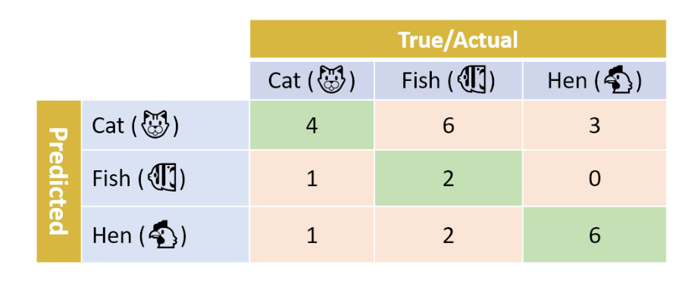
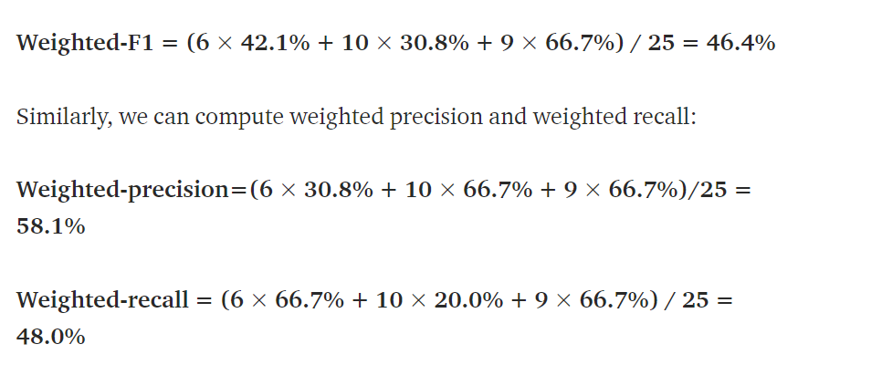
Weighted-average F1-score: weight the F1-score of each class by the number of samples from that class. In our case, we have a total of 25 samples: 6 Cat, 10 Fish, and 9 Hen. The weighted-F1 score is thus computed as follows:

Slide 27
Receiver Operating Characteristic (ROC)
Area Under the Curve (AUC)

Slide 28
AUC-ROC Curve
ROC (Receiver Operating Characteristics) Curve
ROC stands for Receiver Operating Characteristics, and the ROC curve is the graphical representation of the effectiveness of the binary classification model. It plots the true positive rate (TPR) vs the false positive rate (FPR) at different classification thresholds.
AUC (Area Under Curve) Curve
AUC stands for Area Under the Curve, and the AUC curve represents the area under the ROC curve. It measures the overall performance of the binary classification model. As both TPR and FPR range between 0 to 1, So, the area will always lie between 0 and 1, and A greater value of AUC denotes better model performance. Our main goal is to maximize this area in order to have the highest TPR and lowest FPR at the given threshold

Slide 29
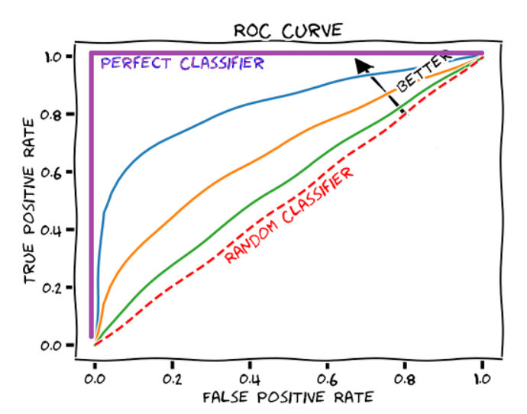
AUC-ROC Curve
The AUROC for a given curve is simply the area beneath it. The worst AUROC is 0.5, and the best AUROC is 1.0.
An AUROC of 0.5 (area under the red dashed line in the figure above) corresponds to a coin flip, i.e. a useless model.
An AUROC less than 0.7 is sub-optimal performance.
An AUROC of 0.70 – 0.80 is a good performance.
An AUROC greater than 0.8 is an excellent performance.
An AUROC of 1.0 (area under the purple line in the figure above) corresponds to a perfect classifier

